Slide 1
Chapter 3: Java Access Modifiers

Slide 2
Learning Objectives
Package declaration
Accessibility modifiers
Simple Imports & Static Imports
Java Programming Structure

Slide 3
Creating and Using Packages
To make types easier to find and use, to avoid naming conflicts, and to control access, programmers bundle groups of related types into packages.
Definition: A package is a grouping of related types providing access protection and name space management. Note that types refers to classes, interfaces, enumerations, and annotation types. Enumerations and annotation types are special kinds of classes and interfaces, respectively, so types are often referred to in this lesson simply as classes and interfaces.
The types that are part of the Java platform are members of various packages that bundle classes by function: fundamental classes are in java.lang, classes for reading and writing (input and output) are in java.io, and so on. You can put your types in packages too.
The types that comprise a package are known as the package members.
The package statement must be the first line in the source file.
There can be only one package statement in each source file, and it applies to all types in the file.
To use a public package member from outside its package, you must do one of the following:
Refer to the member by its fully qualified name
Import the package member
Import the member's entire package

Slide 4
Apparent Hierarchies of Packages and Ambiguities
At first, packages appear to be hierarchical, but they are not. For example, in our code we have a com.janbask package, a com.janbask.packages package, and a com.janbask.program package. However, the com.janbask.program package and the com.janbask.packages package are not included in the com.janbask package. The prefix com.janbask is used for both to make the relationship evident, but not to show inclusion.
Importing com.janbask.* imports all of the types in the com.janbask package, but it does not import com.janbask.packages or com.janbask.program packages. If you plan to use the classes and other types in com.janbask.packages as well as those in com.janbask.program, you must import both packages with all their files.
If a member in one package shares its name with a member in another package and both packages are imported, you must refer to each member by its qualified name.

Slide 5
The Static Import Statement
There are situations where you need frequent access to static final fields (constants) and static methods from one or two classes. Prefixing the name of these classes over and over can result in cluttered code. The static import statement gives you a way to import the constants and static methods that you want to use so that you do not need to prefix the name of their class.
Ordinarily, to use these objects from another class, you prefix the class name.
You can use the static import statement to import the static members of a class so that you don't need to prefix the class name.
Once they have been imported, the static members can be used without qualification.
Obviously, you can write your own classes that contain constants and static methods that you use frequently, and then use the static import statement.

Slide 6
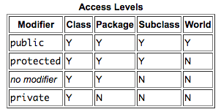
Access Modifiers
Access level modifiers determine whether other classes can use a particular field or invoke a particular method.
There are two levels of access control:
At the top level—public, or package-private (no explicit modifier).
At the member level—public, private, protected, or package-private (no explicit modifier).
Classes:
A class may be declared with the modifier public, in which case that class is visible to all classes everywhere.
If a class has no modifier (the default, also known as package-private), it is visible only within its own package.
Members:
At the member level, you can also use the public modifier or no modifier (package-private) just as with top-level classes, and with the same meaning.
For members, there are two additional access modifiers: private and protected.
The private modifier specifies that the member can only be accessed in its own class.
The protected modifier specifies that the member can only be accessed within its own package (as with package-private) and, in addition, by a subclass of its class in another package.

Slide 7
Tips on Choosing an Access Level
If other programmers use your class, you want to ensure that errors from misuse cannot happen. Access levels can help you do this.
Use the most restrictive access level that makes sense for a particular member. Use private unless you have a good reason not to.
Avoid public fields except for constants. Public fields tend to link you to a particular implementation and limit your flexibility in changing your code.
More on this when we discuss inheritance concepts in chapter 4 and Chapter 5

Slide 8
Java Program Structure

Slide 9
Java Program Structure
“package sct”: It is package declaration statement. The package statement defines a namespace in which classes are stored. The package is used to organize the classes based on functionality. If you omit the package statement, the class names are put into the default package, which has no name. Package statement cannot appear anywhere in the source file except to be the first statement (comments are allowed to appear before it).
“public class HelloWorld”: This line has various aspects of java programming.
public: This is access modifier keyword which tells compiler access to class.
class: This keyword used to declare a class. Name of class (HelloWorld) followed by this keyword.
Comments section: We can write comments in java in two ways.
Line comments: It starts with two forward slashes (//) and continues to the end of the current line. Line comments do not require an ending symbol.
Block comments: start with a forward slash and an asterisk (/*) and end with an asterisk and a forward slash (*/). Block comments can also extend across as many lines as needed.
“public static void main (String [ ] args)”: program entry point

Slide 10
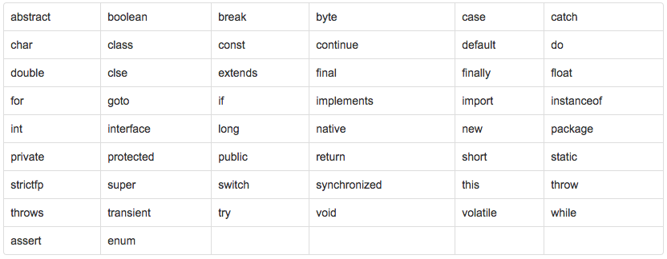
Java Language Keywords
You can’t use Java keywords as identifiers, Below table shows a list of Java keywords.

Slide 11
Examples: Chapter 3
See COREJ1-Chapter3 at https://github.com/CompleteJavaTraining/JavaEssentials/tree/master/Code/COREJ1-Chapter3

Slide 12
What are we learning in Next Chapter ?
You will learn about Object Oriented Programming with Java
We will learn about:
Package Declaration in OOPs context
Accessibility Modifiers & Import statement in object oriented context
Encapsulation
Inheritance (IS-A Relationship)
Polymorphism
Method Signature
Overloading

Slide 13
Thank You !

